Slide 1

HOSPITALITY
Done By
Prahasit, Rohit, Sahoo, Alsha, Prerana, Somya, Sumit

Slide 2

INTRODUCTION
Examines important variables like total bookings, revenue, customer ratings, cancellations, and occupancy by analyzing hotel booking data.
Data gathering, cleaning, and examining using different programs, including SQL, Excel, Power BI, and Tableau.
Created dynamic dashboards to provide insightful information.
Technological proficiency and collaborative efforts.

Slide 3

AGENDA
01
Data overview
02
Objectives
03
Process and Analysis
04
Recommendation and Insights
05
Conclusion

Slide 4

DATA OVERVIEW
1. Data Source: “The dataset was sourced from multiple hotel booking platforms, covering bookings across various cities."
2. Dataset Description: "Our dataset contains hotel booking details, including customer information, booking platforms, revenue, occupancy, and cancellation trends."
3. Key Attributes (Columns Overview): “Important columns in the dataset.”
4. Data Size: "134,000+ records | 10+ key attributes."
5. Time Frame: "Data covers bookings from May 2023 to July 2023."
6. Data Preprocessing: “Data Cleaning Steps Taken”

Slide 5




Total revenue
1.69bn
Key Performance Indicator is what KPI stands for. It is a quantifiable figure that shows how well a person, group, or company is accomplishing a corporate goal. KPIs are used in many departments and industries to monitor performance, pinpoint areas that need work, and make well-informed decisions that propel company success.
Benefits of KPI:
1.Performance Monitoring
2.Making Decisions
3.Continuous Improvement
Total bookings
132.94K
Occupancy
57.79%
Cancellation
24.84%
OBJECTIVES

Slide 6
ADR
14.92K
DBRN
1.46k
DSRN
2.53k
RevPAR
8.63k
KPI used in this Project:
Tracking the total bookings, occupancy rate, cancellation rate, total revenue, ADR, RevPAR, DSRN, DBRN, etc. KPIs provides several strategic advantages.
These metrics help hotel management like
optimize operations, increase profitability,
and improve guest satisfaction.

Slide 7
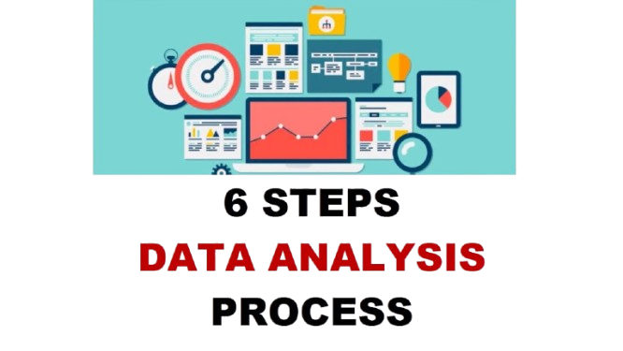
PROCESS
Data Collection & Cleaning:
Gathered raw hospitality data from multiple sources.
Cleaned and transformed data using Power Query for consistency and accuracy.
Data Analysis & Transformation:
Analyzed the dataset to identify key metrics and patterns.
Added new calculated columns to enhance analysis.
Created complex measures using DAX for advanced calculations.
Data Modeling:
Established relationships between 4-5 tables to create a unified data model.
Ensured accurate data flow and connectivity for better insights.

Slide 8
Excel Analysis & Pivot Tables:
Built Pivot Tables for in-depth data analysis.
Added slicers to enable easy filtering and dynamic exploration.
Data Visualization & Dashboard Creation:
Loaded the refined data into visualization tools (Power BI & Tableau).
Designed and developed interactive dashboards with essential charts.
Highlighted key insights on booking trends, occupancy, revenue, and cancellations.
Stakeholder Decision Support:
Delivered actionable insights to assist stakeholders in data-driven decision-making.
Created user-friendly, interactive dashboards showcasing business trends and KPIs.

Slide 9

ANALYSIS
Booking Trends:
Identified peak periods and customer acquisition patterns.
Occupancy & Revenue:
Evaluated rates, optimized high-performing segments.
Cancellation Patterns:
Analyzed causes and suggested strategies to reduce cancellations.
Customer Feedback:
Assessed ratings to identify areas for improvement.
Operational Efficiency:
Suggested data-driven strategies to enhance performance.

Slide 10
Leverage Booking Platforms
Optimize Pricing & Promotions
Enhance Customer Experience
Minimize Cancellations
RECOMMENDATION AND INSIGHTS
Focus marketing efforts on platforms generating the most revenue.
Adjust pricing for low-occupancy hotels to increase bookings.
Encourage more guests to leave ratings for service improvements.
Implement better booking policies to reduce lost revenue.

Slide 11

CONCLUSION
Through comprehensive data analysis and visualization, we delivered actionable insights that empower stakeholders to make informed decisions. Our interactive dashboards effectively highlight key business metrics, facilitating better understanding of booking trends, revenue optimization, and customer behavior. This project demonstrates the value of data-driven strategies in improving operational efficiency and enhancing business performance.
Next Steps: Implement strategies based on these insights and monitor the impact.

Slide 12
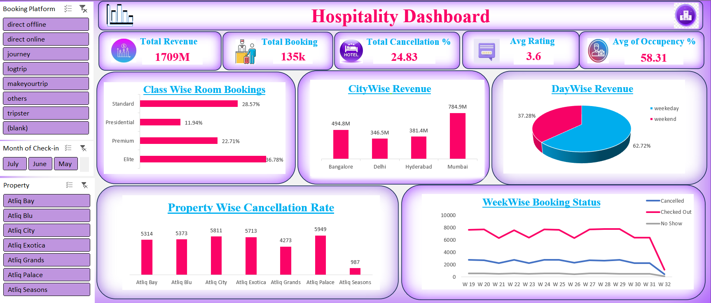

Slide 13
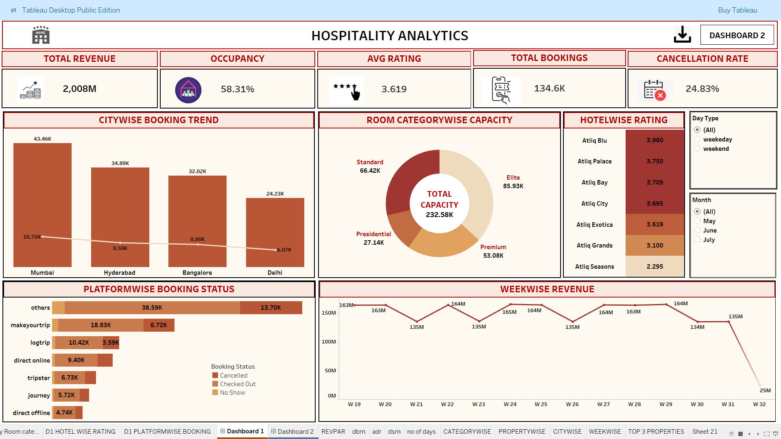

Slide 14
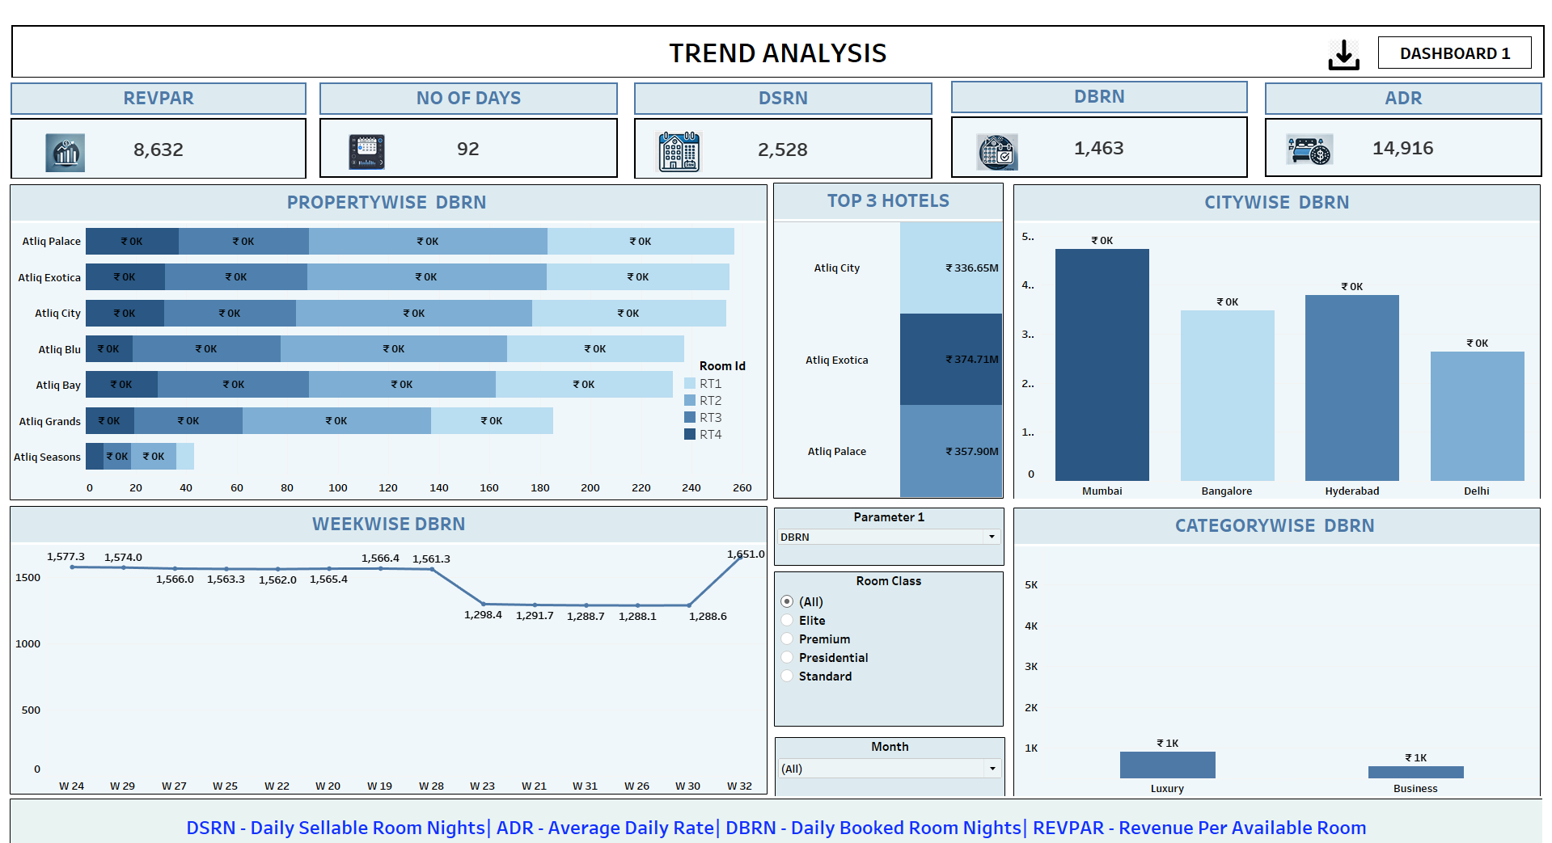

Slide 15
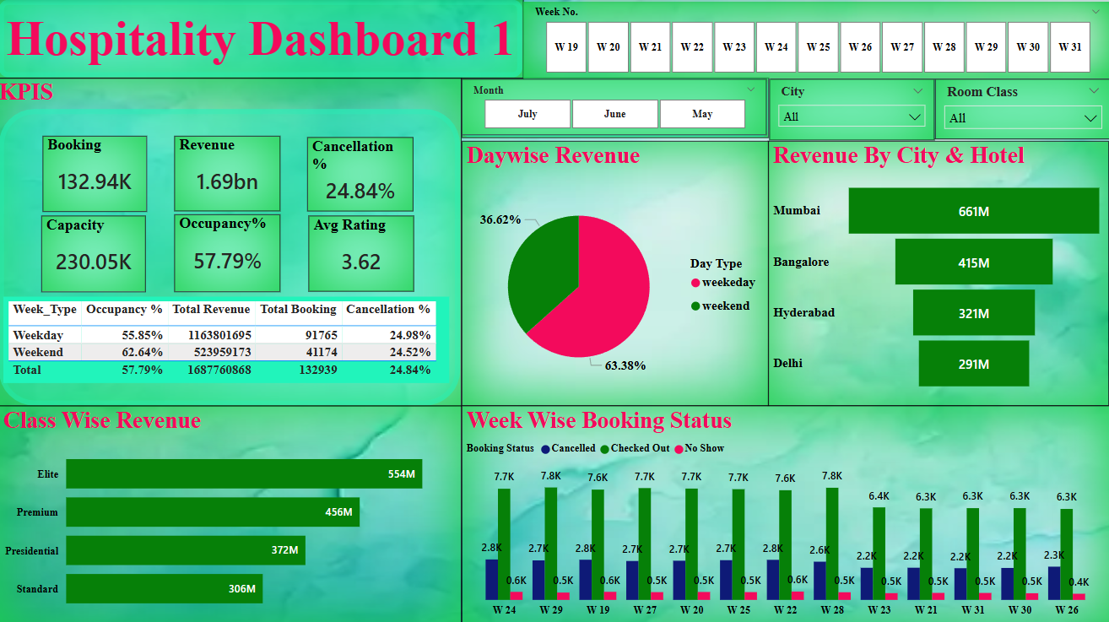

Slide 16
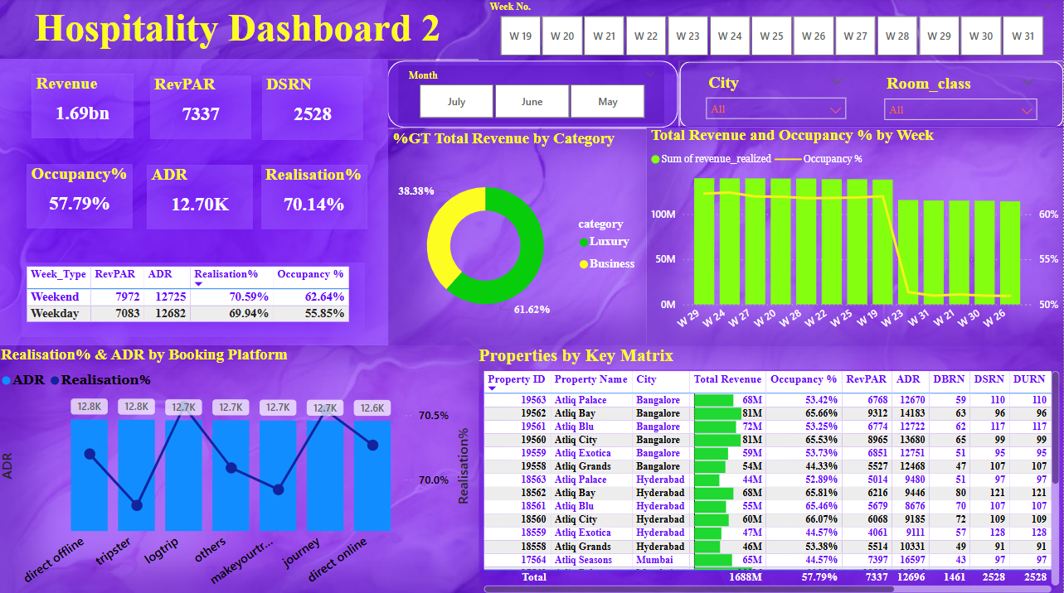

Slide 17
THANK YOU
We appreciate your time and attention. Please reach out if you have any further questions.

